Slide 1
SSI Model in the
Collaborative Innovations
in Universities
By：Yang Xue（No.18）

Slide 2
CONTENTS
SSI model
Knowledge transformation of system knowledge base
Knowledge sharing of innovation subject
Transfer and transformation of knowledge
Knowledge innovation

Slide 3
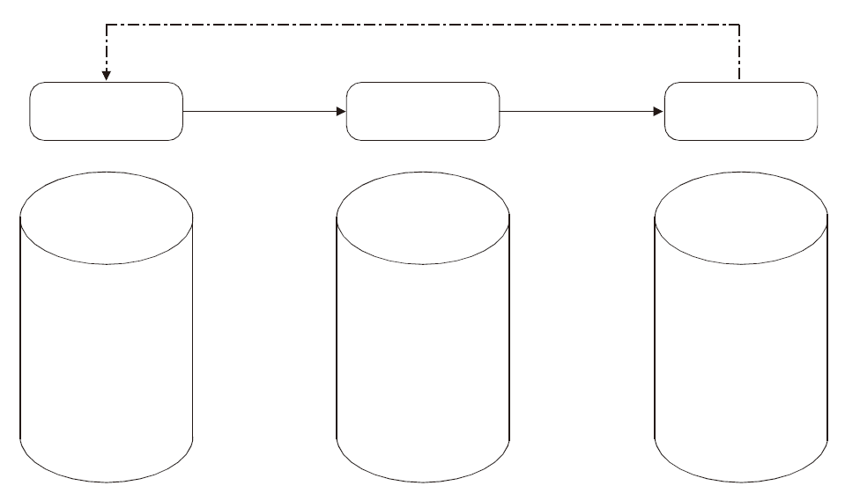
SSI model
Knowledge adjustment and feedback
Knowledge
acquisition (s)
Knowledge
sharing (s)
Knowledge
innovation(I)
On the basis of knowledge sharing, through the SECI transformation mechanism, new knowledge is constantly generated and knowledge spiral is formed.
Collect the dominant knowledge (explicit and implicit) of each innovation body, and use XML technology to build collaborative knowledge base
Through learning and using the collaborative knowledge base, promote the flow of knowledge, get what they need.
SSI model of knowledge management in university collaborative innovation

Slide 4
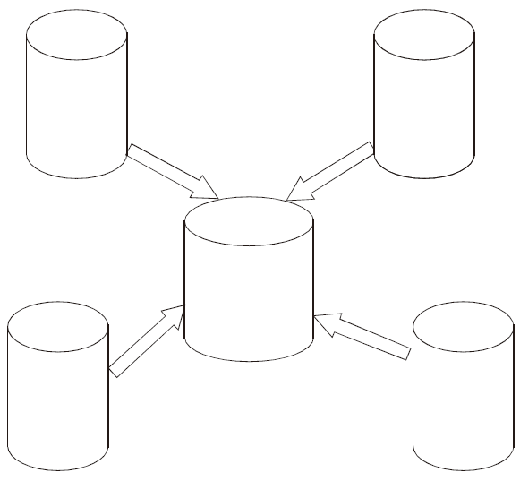
Knowledge transformation of system knowledge base
University knowledge base
Explicit knowledge
Tacit knowledge
Enterprise
knowledge base
Explicit knowledge
Tacit knowledge
XML transformation
XML transformation
Collaborative innovation knowledge base
Explicit knowledge base
Tacit knowledge base
Research knowledge base
Explicit knowledge
Tacit knowledge
Government knowledge base
Explicit knowledge
Tacit knowledge
XML transformation
XML transformation

Slide 5
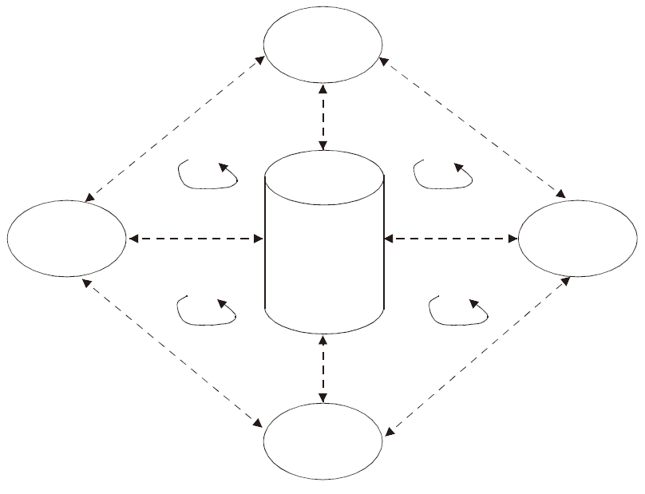
Knowledge sharing of
innovation subject
Colleges
Collaborative learning
Collaborative learning
Knowledge transfer
Knowledge flow
Knowledge flow
Collaborative innovation knowledge base
Explicit knowledge base
Tacit knowledge base
Research
institutes
Knowledge transfer
Knowledge transfer
Enterprise
Knowledge flow
Knowledge flow
Collaborative learning
Knowledge transfer
Collaborative learning
Government

Slide 6
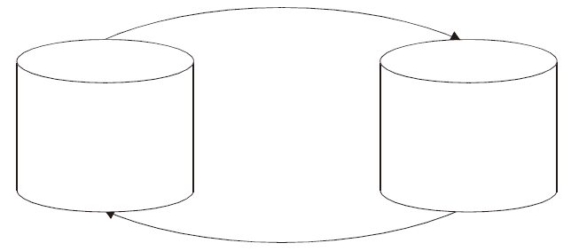
Transfer and transformation of knowledge
Knowledge tools transformation, knowledge fusion and other processes
Collaborative subject knowledge base
Explicit knowledge
Tacit knowledge
Collaborative subject knowledge
Explicit knowledge
Tacit knowledge
Learning, absorption, processing, transformation and innovation

Slide 7
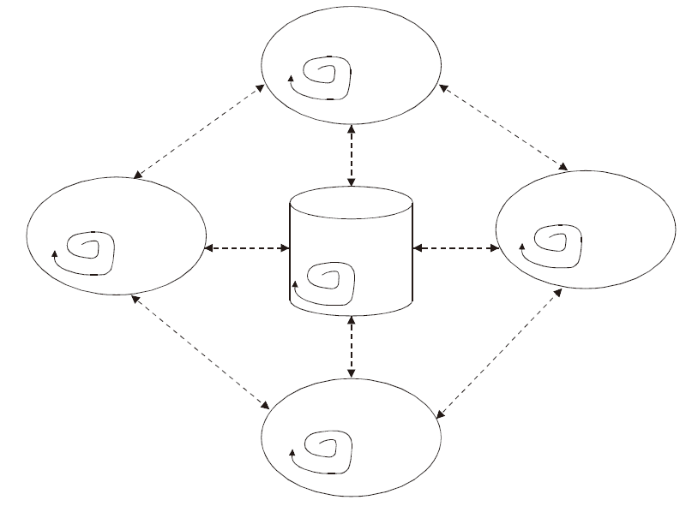
Knowledge innovation
Colleges
SECI spiral
Knowledge transfer
Knowledge transfer
Research institutes
Enterprise
Collaborative knowledge base
SECI spiral
SECI spiral
Knowledge
transfer
SECI spiral
Knowledge
transfer
Knowledge transfer
Knowledge transfer
Government
SECI spiral

Slide 8
THANKS

